Slide 1
COVID-19 DIGITAL LISTENING for
PROPERTY & CASUALTY
Group and Individual Benefits Insights and Competitor Trends
How the P&C Industry Became More Strategically and Technologically Agile
After the Emergence of COVID-19.
SUMMARY REPORT
Notes:
Company name can be typed in where 2019 is

Slide 2
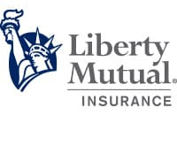
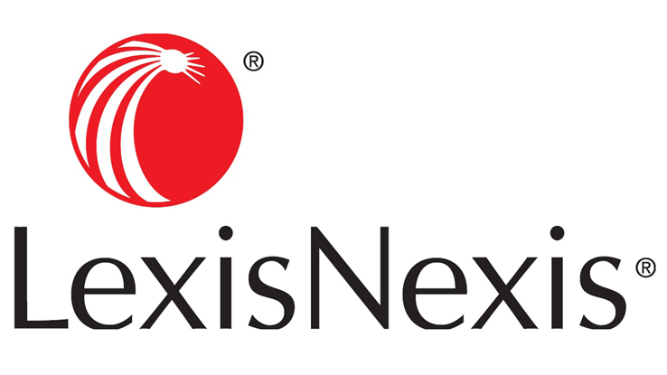
How the P&C Industry Became More Strategically and Technologically Agile
“We really can change more aggressively.”
-Liberty Mutual Claims Manager & VP of US retail markets.
AN INDUSTRY RECAP: MARCH TO JULY 2020
COVID-19 disrupted the P&C insurance industry unlike any other moment in recent history.
The pandemic has forced insurers to move faster, lean more heavily on digital, reimagine how to effectively utilize sales channels, and to provide consumers with tangible moments of genuine support that demonstrate they care about their customers.
It’s been called a “tipping point” for the industry – and we agreed. Inside, we’ll share 4 trends that have been amplified or newly emerged during the pandemic – each of which has long-term implications for competing in the P&C industry’s ‘new normal.’
USAA auto claims Vice President Anne Warner said her carrier had learned, “‘Let’s allow progress over perfection.'”
“2020 posed a tipping point for claims, and insurers won’t revert to their old processes, LexisNexis auto claims Vice President Bill Brower predicted. “I think that will change,” he said.
Notes:
Source of Quotes: https://www.repairerdrivennews.com/2020/06/29/ccc-says-photo-estimating-booms-lexisnexis-calls-2020-virtual-claims-tipping-point/

Slide 3
Overview of Four Key P&C Trends
Trend 1
Sales Channel Disruption
Consumers are increasingly shopping and buying auto insurance online – fueling the growth of direct carriers
Trend 3
Speed-to-Market of Digital Claims
Insurers accelerated and widened the use of digital claims processing tools
Trend 4
Lack of Needed Coverage
Business owners have lost trust in their insurers due to lack of support
Auto Insurers
Property Insurers
Business Insurers
Trend 2
Consumer Loyalty Erosion
Many insurers offered rebates or reduced premiums to shore up customer satisfaction
Auto Insurers

Slide 4
01
Auto Insurance

Slide 5
Auto Insurance: The New Normal of Shopping and Switching
Auto Insurers
Economic constraints, shelter-in-place orders, and the dramatic (and almost overnight shift) to remote working made many consumers rethink the value of their existing car insurance.
Despite insurers providing premium rebates to address customer cost concerns, most customers were still looking for further monetary relief via shopping for a new carrier (19%) or switching to a new carrier (20%). ¹ In fact, recent studies have shown, consumers have displayed a 20% increase in price sensitivity when considering carriers. ¹
Further, perceptions and satisfaction with their current auto insurer continued to decline (by 31% in just three weeks), alone resulting in more than a 2x increase in the propensity to shop or switch. ¹
As consumers display increased motivations to shop for insurance, many are doing so online – more than 90% say they are open to shopping online. ¹ In doing so, consumers are finding some of the lowest rates are with direct auto insurance carriers, which appears to be accelerating the growth of that channel.
¹ HubSpot Auto Insurance Study

Slide 6
Sales Channels
Auto Insurers
Consumers are increasingly shopping and buying auto insurance online – fueling the growth of direct carriers
Over half of consumers are planning to shop or switch auto insurers
Why? Consumers are looking to lower household costs
GEICO and Progressive have captured nearly 92% of all premium growth in 2019 and will likely see a boost due to increased price sensitivity among consumers due to COVID¹.
Auto insurance costs have risen at 2X the rate of inflation, making it a larger share of discretionary income. ¹
“92% of premium growth”
“Add the effects of record high levels of unemployment and the 52% of auto insurance customers who say they plan to either reduce coverage, shop for another carrier or switch to another carrier because of COVID-19, and the outcome is clear: price is going to be a bigger factor.”
-Tom Super, head of property & casualty at J.D. Power ¹
More consumers are shopping and buying auto insurance online
Why? Convenience and lower costs are primary drivers
90% of customers say they are open to purchasing their auto insurance online.¹
“Lower commissions and admin expenses enable direct carriers to enjoy a 10-percentage point cost advantage vs. exclusive independent agent carriers.”¹
Jan/Feb 2020
Mid-Mar/ Mid-May 2020
Google Searches for
Car Insurance²
“Cheap car insurance”
#3
#1
¹J.D. Power Shopping Study
²Bain & Company
“Online car insurance”
#17
#9
Notes:
²McKinsey, Direct Insurance

Slide 7
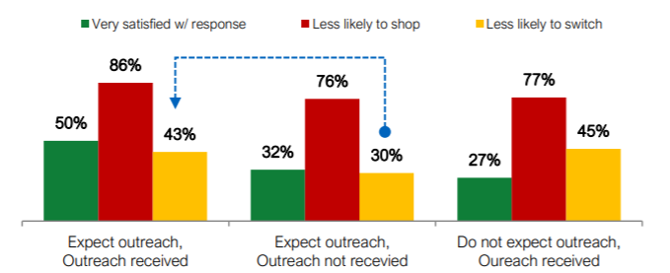
Customer Support
Auto Insurers
Many insurers offered rebates or reduced premiums to shore up customer satisfaction
Consumers are increasingly dissatisfied with their auto insurance
Why? Consumers’ new driving behaviors do not align with current policies
Issued Auto Insurance Rebates
In 3 weeks, the number of consumers who are very satisfied with their auto insurance declined by 31%.¹
While 50% of customers expected to be contacted by their auto carrier about COVID-19, only 36% were.¹
$4.2 billion
$2.5 billion
$1 billion
$1 billion
Customers who expect to be contacted, but aren’t, are almost 2x more likely to switch carriers. ¹
Carriers issued premium rebates or reduced rates
Why? To bolster member satisfaction
State Farm provided the largest rebate, totaling $4.2B, followed by Geico ($2.5B), and Progressive and Allstate ($1B each).²
However, only 37% of consumers were aware of their carrier’s announced premium relief efforts.¹
Even among consumers who believe premium relief efforts are enough to ease financial pressure, they displayed 1.3x increase in shopping rates and a 1.7x increase in likelihood to cancel a policy.¹
Expectation vs. Reality of Communication²
¹ HubSpot
² S&P Global

Slide 8
Looking Ahead for Auto Insurers
Ongoing Trends
Go-to-Market Considerations
As a result of COVID-19 consumers are increasingly sensitive to price:
Cost will continue to be one of the highest priorities when considering, shopping and buying insurance
Driving behaviors will continue to be abnormal as people remain working from home
Auto insurance options like usage-based insurance (UBI) should see significant tailwinds
Telematics (in-vehicle tracking devices) will likely be of interest to consumers who are limiting their driving and want to save money

Slide 9
02
Property Insurance

Slide 10
Property Insurance: Accelerating the Digital Claims Process
Property Insurers
Damage to property from weather-related incidents did not cease due to the pandemic. Home and property owners in need of filing claims experienced new ways to interact with insurers.
Shelter-in-place and social distancing orders meant property insurance agents were unable to make in-person visits to assess the damage. In order to process claims in a timely manner, property insurers accelerated the roll out and expanded the use of digital tools within the claims process.
Liberty Mutual alone estimates COVID has pulled forward its claims’ advancements by several years.
While recent studies have commended the increased investments P&C insurers have allocated towards elevating their digital experiences to meet customers’ digital expectations, COVID-19 has underscored the absolute necessity for carriers to accelerate the implementation – and consumer experience – of those digital-first experiences.

Slide 11
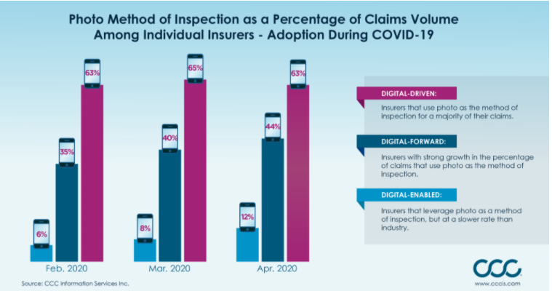
Digital Tools
Speed-to-Market
Property Insurers
Insurers accelerated and widened use cases of digital claims processing tools
Insurers quickly pivoted to contactless claims technologies
Why? Meeting an agent face-to-face became unsafe
Traditional insurers increased the number of claims processed virtually by an estimated 40% in a few months, since COVID began.¹
The Central Insurance Companies reported a record expansion rate for photo estimates and virtual claims since January 1.​​ ²
Mercury Insurance allowed homeowners and claims handlers to interact and share video through an app to support social distancing practices.
“Industry use of photos for method of inspection has been growing and insurers are seeing benefit to both cycle time and customer satisfaction,”
Susanna Gotsch, director, industry analyst, CCC.
Liberty Mutual estimates COVID has pulled forward its claims’ advancements by several years.
¹ RDN
²CCC

Slide 12
Looking Ahead for Property Insurers
Ongoing Trends
Go-to-Market Considerations
Digital tools that provide an easy and contactless way for consumers and carriers to interact with each other will continue to gain adoption:
Microsites for members to access critical information quickly as needed (also helps to reduce 1:1 outreach by employees and/or agents)
Accelerating the modernization of the digital underwriting process and digital payments
Continuing to digitize steps within claims processes (for members and employees alike)
Agility to quickly re-prioritize and deploy resources against digital initiatives will be imperative:
Contactless touchpoints like chatbots and AI assistants to help maintain quality interactions with members, and increase member satisfaction
AI and other predictive technology to analyze and uncover trends in data
Automation of claims processing to allow employees to focus on more critical tasks
Notes:
https://www.mindtree.com/about/resources/covid-19-impact-pc-carriers
https://www.propertycasualty360.com/2020/07/30/streamlining-the-pc-claims-experience-challenges-and-solutions/
https://www2.deloitte.com/content/dam/Deloitte/us/Documents/financial-services/us-deloitte-property-casualty-insurance-remade-by-covid19.pdf

Slide 13
03
Business
Insurance

Slide 14
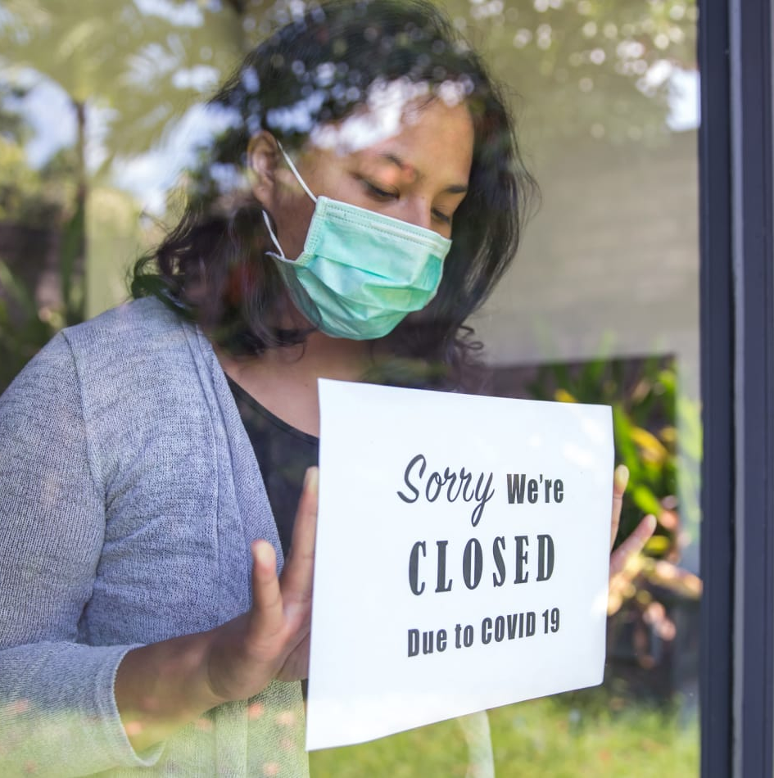
Business Insurance: The Debate Over Business Interruption Insurance
Business Insurers
Many business owners experienced a drastic drop-off in revenue as consumers were asked to follow government-mandated stay-at-home orders.
Those business owners with business interruption insurance believed the coverage they have been paying for would cover the losses incurred by the pandemic, as it was an issue outside of their control. However, shock set in when business owners found out their business interruption coverage would not coverage COVID related losses.
Perhaps indicative of what is to come, recent lawsuits brought forth by businesses seeking financial support from their insurers have ruled in favor of the insurer. If this trend continues, businesses will continue to question not only the need of business interruption coverage going forward, but the value of their partnerships with insurers.

Slide 15
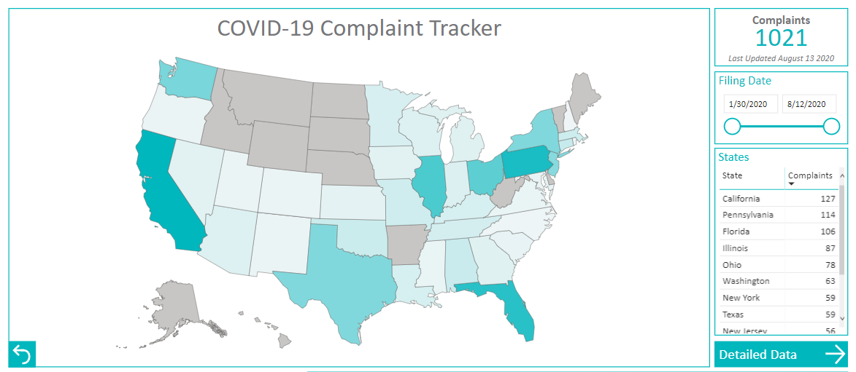
Customer Support
Business Insurers
Business owners have lost trust in their insurers due to lack of assumed coverage
Small businesses struggle to keep afloat as the pandemic persists
Why? SMBs were forced to shutdown for an extended period of time
“The American Property Casualty Insurance Association has estimated that if insurers were required to cover all U.S. business interruption losses tied to the shutdowns, regardless of policy exclusions, it would cost $1 trillion a month”
Prior to the pandemic, the average small business was only holding a 27-day cash buffer in reserve. ¹
In early May, 7.2% of SBOs said they were certain couldn’t stay open, up from 5.3% in mid-April.²
As of July, more than half are still worried they may have to permanently close.³
Business owners may begin to question the need for business insurance
Why? Carriers are denying business interruption claims for damages due to COVID
As of August, more than 1,000 COVID-19 related insurance lawsuits have been filed.⁴
A Michigan Court ruled in favor of the insurer in a case where restaurants were seeking insurance coverage due to COVID-19-shutdowns but physical damage to the properties was not proven.⁵
¹ McKinsey
² Pymnts
³ US Chamber
⁴ Insurance Journal
⁵ PropertyCasualty 360

Slide 16
Looking Ahead for Business Insurers
Ongoing Trends
Go-to-Market Considerations
Small businesses will continue to look for help to stay in business but feel unsupported by their insurer
Small businesses will continue to navigate their local reopening procedures to ensure staff and customers are safe
Leadership on a local or personal level (1:1 outreach via agents) if possible, to businesses about:
Preparing for a possible second wave of the virus – purchasing PPE, increasing digital payment options and getting finances in order
Re-assess the new normal to ensure the insurance coverage provided is still a good fit
Notes:
Source of Quotes: https://www.repairerdrivennews.com/2020/06/29/ccc-says-photo-estimating-booms-lexisnexis-calls-2020-virtual-claims-tipping-point/

Slide 17
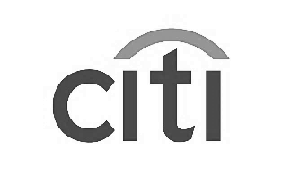
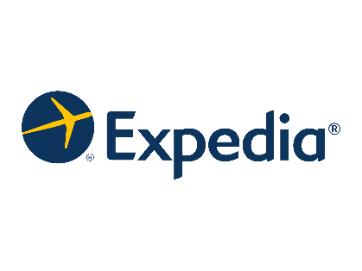
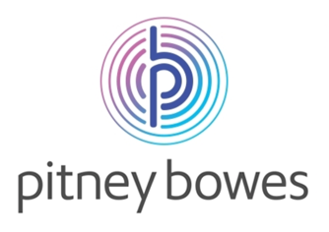
+
Your Partner in Market Research
50
Fortune 1000 clients
Based on 25+ years of experience, made actionable with industry-specific best practices and benchmarks, we connect always-on strategy with agile execution to future-proof your success.
MULTICHANNEL GO-TO-MARKET STRATEGY
MARKET INTELLIGENCE
CUSTOMER ANALYTICS
MARKETING
& SALES ENABLEMENT
Capture timely and actionable customer, competitor, and partner insights to drive change
Harness internal and external signals to optimize decisions across the buyer journey
Enable sales and marketing with the right content for every buyer at every stage
MARKET-BRIDGE.COM >

